Slide 1
UNESP 1
2021

Slide 2
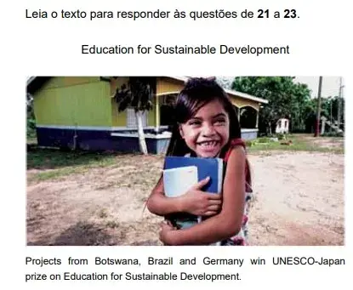
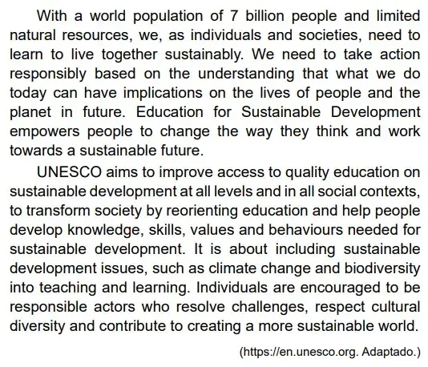
TEXTO PARA AS QUESTÕES DE 21 A 23

Slide 3
QUESTÃO 21
According to the first paragraph, it is important to promote a sustainable development because
There are far too many people for too little natural resources.
Individual needs should be considered above social needs.
People will always keep the way they are in the world.
Most of the 7 billion people are not aware of sustainability
It is too costly to achieve without incentives.

Slide 4
QUESTÃO 22
According to the second paragraph, one of sustainable development initiatives to be tackled by education should be to
Develop skills necessary for work.
Add climate change themes into school dynamics.
Help people acquire basic and general knowledge.
Enforce quality education in some specific contexts.
Stimulate creativity, art and acting.

Slide 5
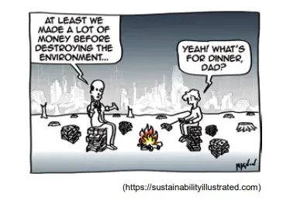
QUESTÃO 23
O cartum dialoga com o seguinte trecho do texto “Education for Sustainable Development”:
“UNESCO aims to improve access to quality education on sustainable development”.
“Education for Sustainable Development empowers people to change the way they think”.
“Individuals are encouraged to be responsible actors who resolve challenges”.
“What we do today can have implications on the lives of people and the planet in future”.
E. “A world population of 7 billion people”.

